Slide 1

AIRBNB Data Analysis
By: Shraddha Pawar

Slide 2
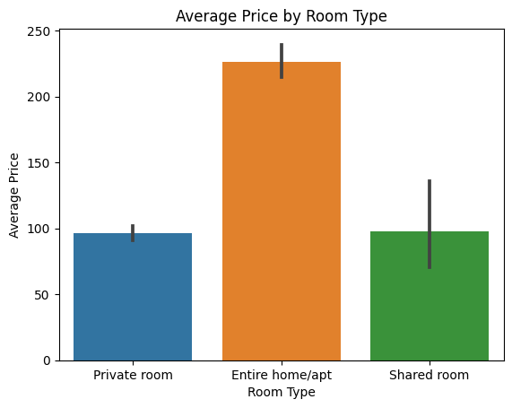
Room Type Analysis
Entire room or apartment is most expensive compared to private room and shared rooms
maximum no. of people prefers Entire room/apt type rooms

Slide 3
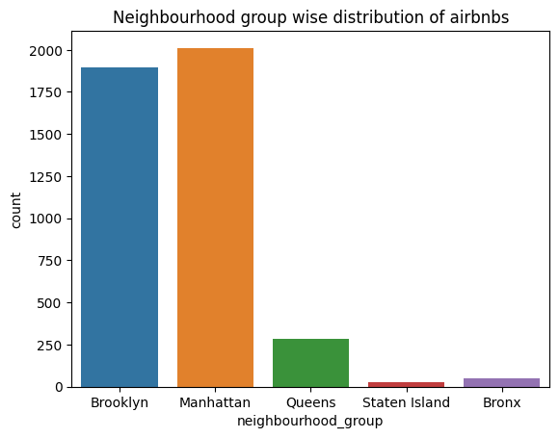
Neighborhood group wise distribution of Airbnb
Manhattan has the highest number of Airbnb listings compared to other neighborhoods in NYC

Slide 4
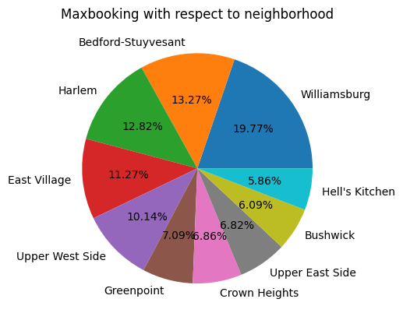
Maximum booking with respect to neighborhood
Williamsburg has maximum number of room bookings
Williamsburg have 19.77% of room booking

Slide 5
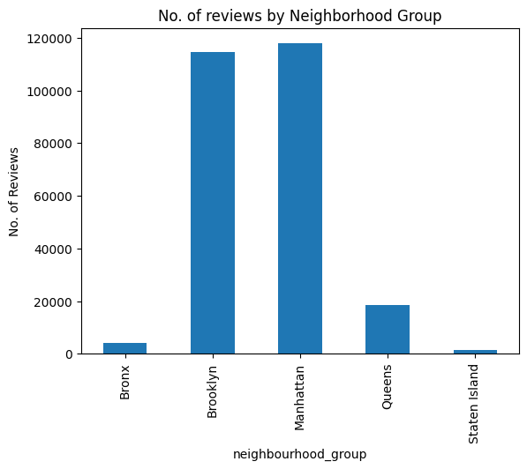
No. of reviews by Neighborhood Group
Manhattan has maximum no. Of reviews

Slide 6

Insights
Entire room or apartment is the most expensive compared to private room and shared rooms.
The majority of people prefer booking entire room or apartment listings.
Manhattan has the maximum number of Airbnb listings in the whole of NYC.
Williamsburg has the maximum number of room bookings.
Manhattan has the maximum number of reviews among all neighborhoods.

Slide 7
Thank you

